Slide 1
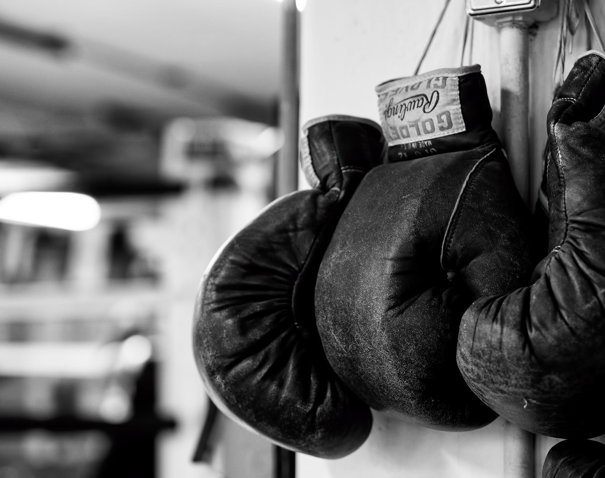
Boxing with George Box
Kenneth Lee
Duke-NUS Medical School, Singapore
Notes:
Presenting my submission for the Significance Magazine writing competition

Slide 2
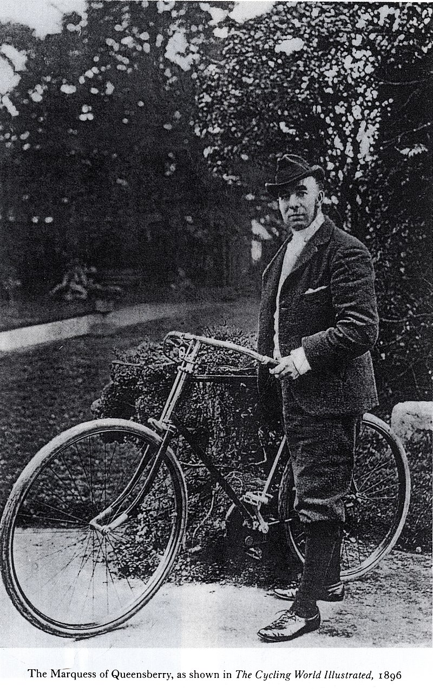
The Beginning
Modern boxing came about in 1867 with the introduction of the “Queensberry Rules”
Notes:
“This is the man that invented modern boxing, it is a sport defined by the…”

Slide 3
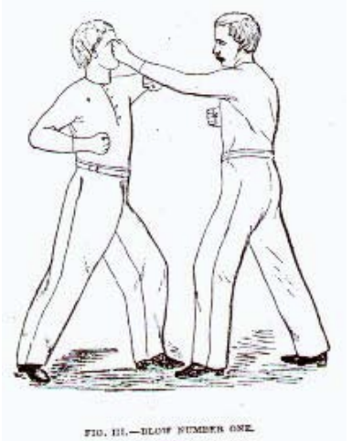
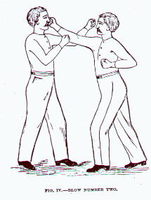
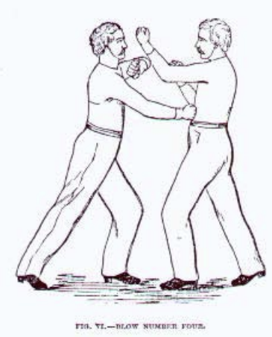
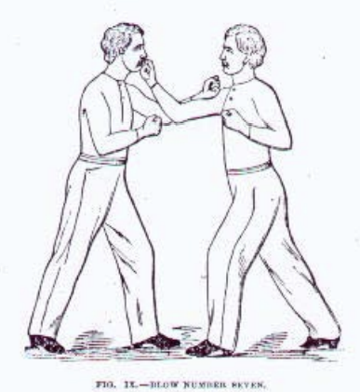
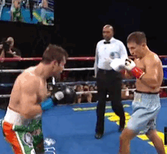
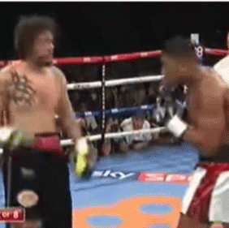
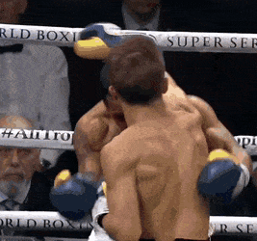
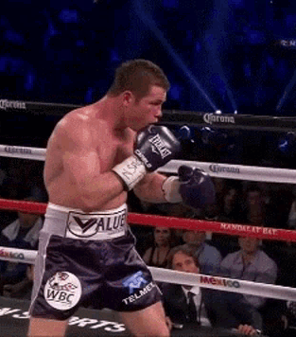
The Punches
Punch #1: The Jab
Punch #2: The Cross
Punch #4 & 5: The Hook
Punch #7: The Uppercut
Which punch is the most useful?
The Science of Defence: A Treatise on Sparring and Wrestling (Price, 1867)
Notes:
“All good punches, all painful punches”
“Maybe one the boxers here can give us a suggestion…”

Slide 4
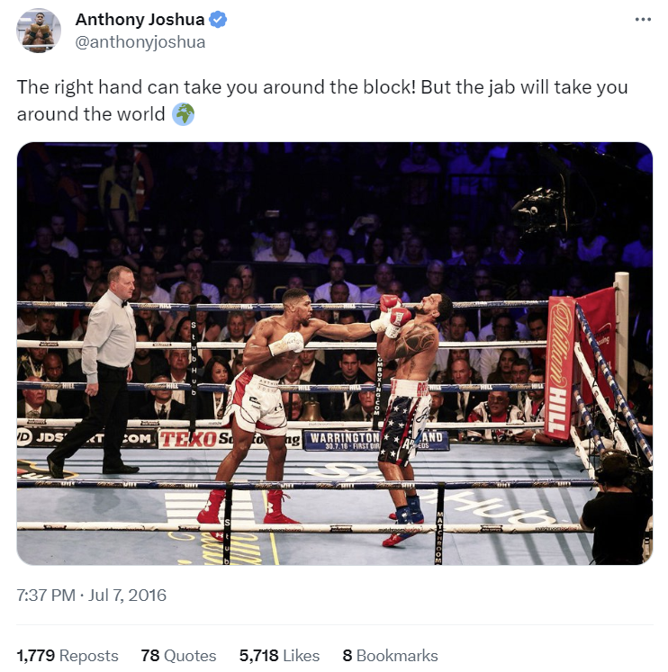
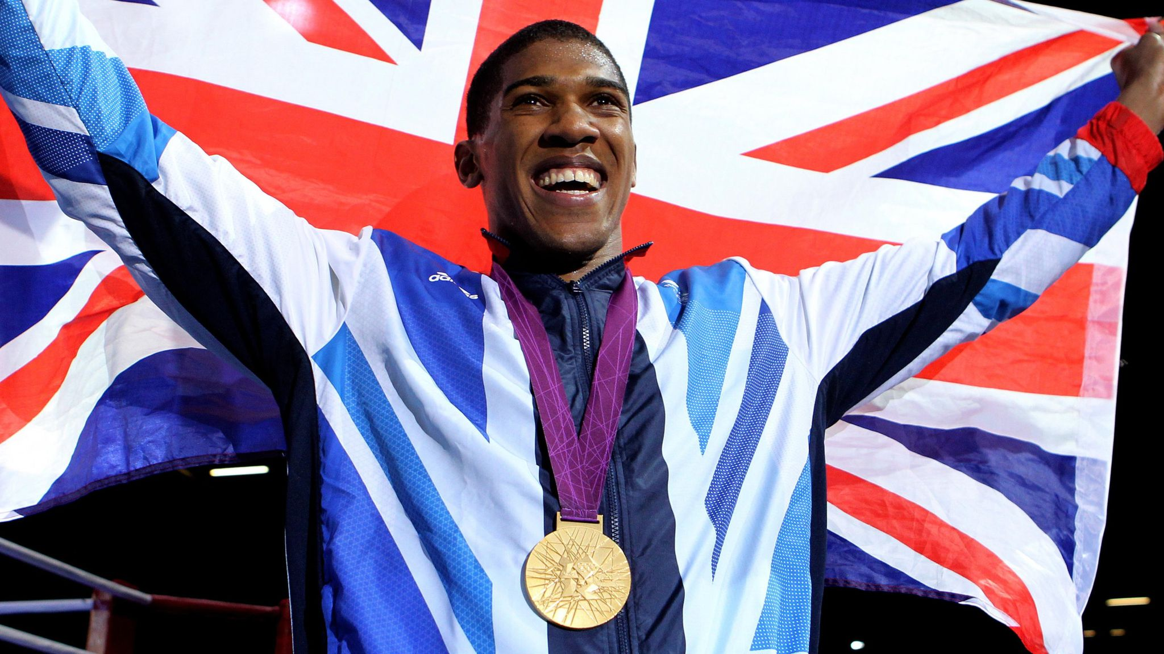
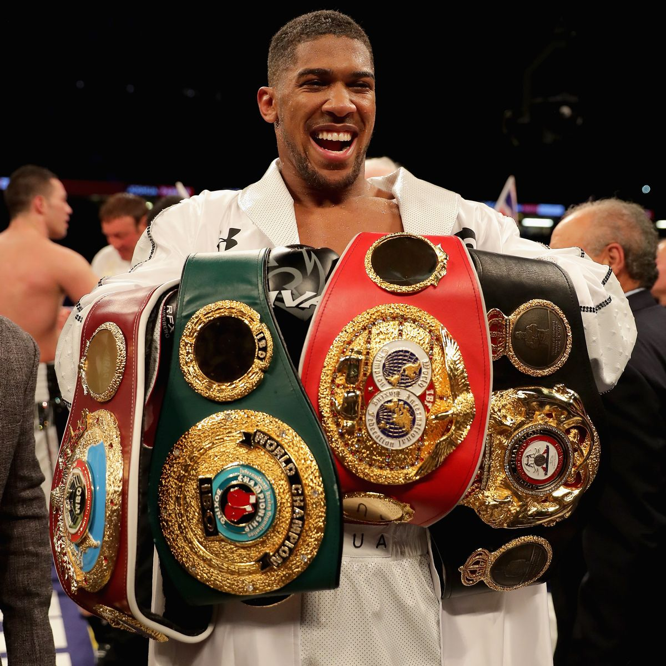
“A Good Jab”
“The old saying is: the right hand could take you around the block, but a good jab will take you around the world.”
- Anthony Joshua (2018)
Notes:
“Anthony Joshua, Olympic gold medalist and former unified heavyweight champion of the world…”
“After defeating Joseph Parker in 2018”
“He actually tweeted this quote 2 years before saying it live -> self-actualization”

Slide 5
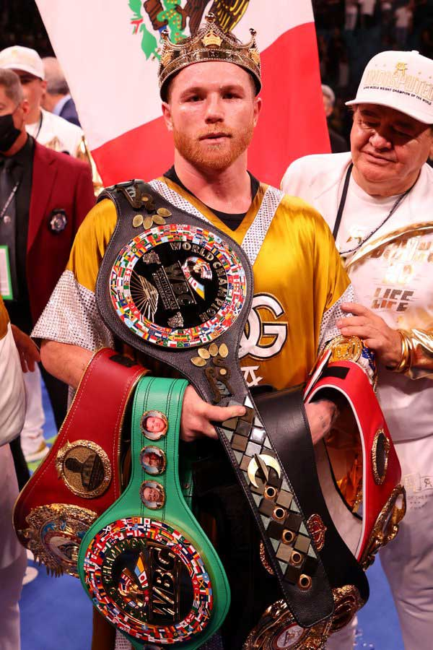
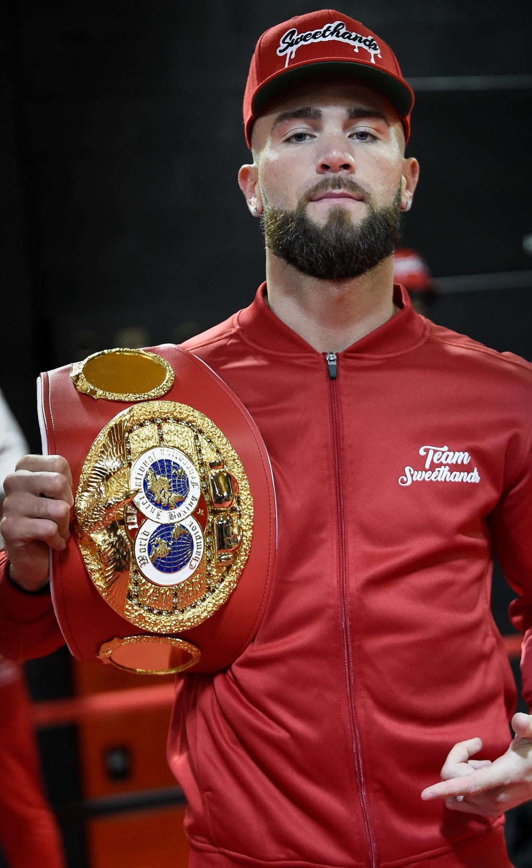
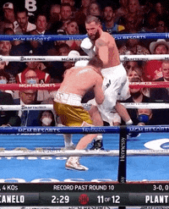
Canelo vs. Caleb Plant (2021)
Fighter | WL | Jabs Thrown (Landed)
Canelo | Won | 110 (15)
Plant | Lost | 232 (42)
Fighter | WL | Jabs Thrown (Landed) | Power Thrown (Landed)
Canelo | Won | 110 (15) | 251 (102)
Plant | Lost | 232 (42) | 209 (11)
Notes:
To be the undisputed super middleweight champion of the world
“throwing and landing half as many jabs, but over two times as many power punches”

Slide 6

Can a good jab really take you around the world?

Slide 7
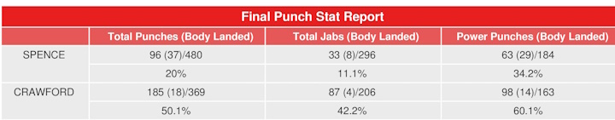
The Data
“Around the world” => winning fights at the highest level
CompuBox: Publishes high profile fight statistics
Notes:
“First let’s start with the data…”
“So I put on my earphones, threw on a podcast, and one Saturday afternoon later, I had my data”

Slide 8
Do winners land more jabs?
263 fights since 2012
Average Jabs Landed:
  Winners: 43
  Losers: 28
Notes:
“But we’re not interested if winners land more jabs…”

Slide 9
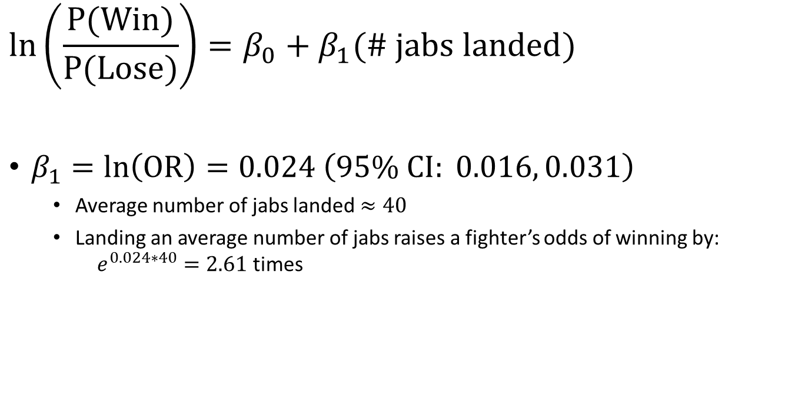
Model 1: Will landing more jabs help you win?
$$\ln\left(\frac{P(Win)}{P(Lose)}\right)=β_{0}+β_{1}(\# jabs landed)$$
$β_{1}=ln\left(OR\right)=0.024 \left(95\% CI: 0.016, 0.031\right)$
  Average number of jabs landed $≈40$
  Landing an average number of jabs raises a fighter’s odds of winning by:
  $e^{0.024∗40}=2.61$ times
But there’s more to consider
Notes:
“will landing more jabs help you win?”
“we use the following model, where…”
“we analyze this using logistic regression, and get a log odds ratio of…”
“There is a statistically significant effect of jabs landed on winning”

Slide 10
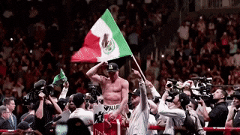
“VIVA MEXICO”
Country of Origin
as a “Confounder”
Notes:
“This brings us to our next section…”

Slide 11
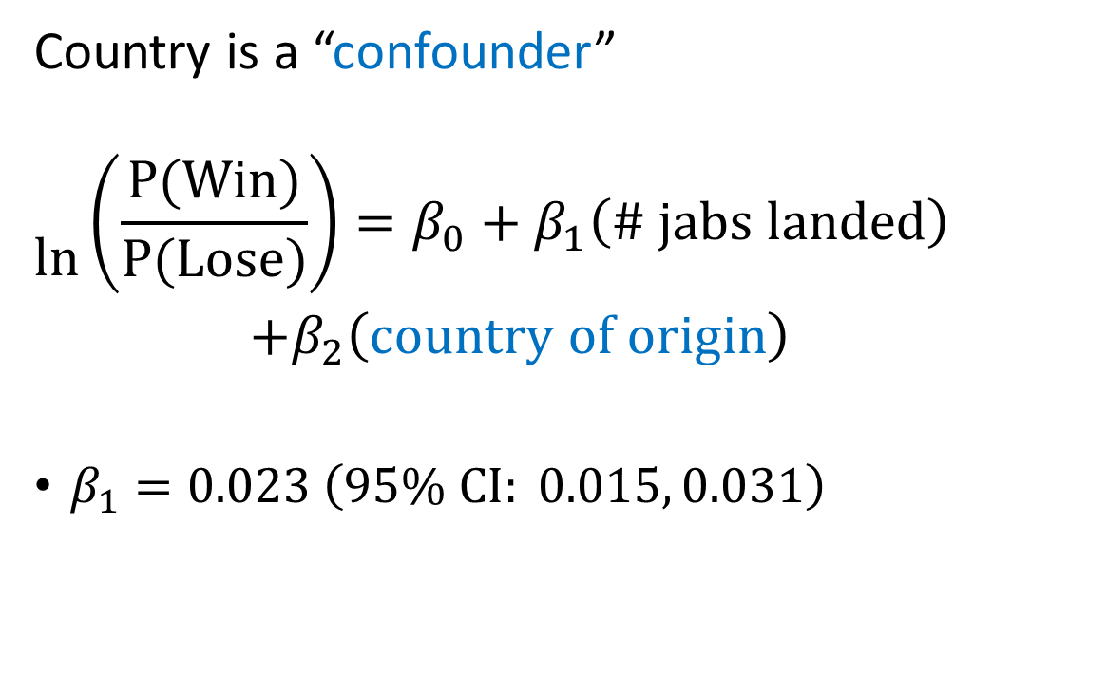
Model 2: “Viva Mexico!”
Country is a “confounder”
$$\ln{\begin{aligned}\left(\frac{P(Win)}{P(Lose)}\right)=β_{0}+β_{1}\left(\# jabs landed\right) \\ +β_{2}\left(country of origin\right)\end{aligned}}$$
$β_{1}=0.023 \left(95\% CI: 0.015, 0.031\right)$
Notes:
“Canelo Alverez was able to become an undisputed champion while barely throwing any jabs.”
“Fighters from different countries have different styles”
Mexican fighters aren’t as well known for their jabs, but are known for their aggression
Russian fighters are well known good jabs
There is a statistically significant effect of jabs landed on winning

Slide 12
“It ain’t about how hard you can hit”
Power punches as a “Mediator”
The Cross
The Hooks
The Uppercut
Notes:
“As we mentioned earlier, there are more punches than just the jab.”
“We aren’t just interested in if a jab can help a boxer win, we’re also interested to see how it compares to power punches…”

Slide 13
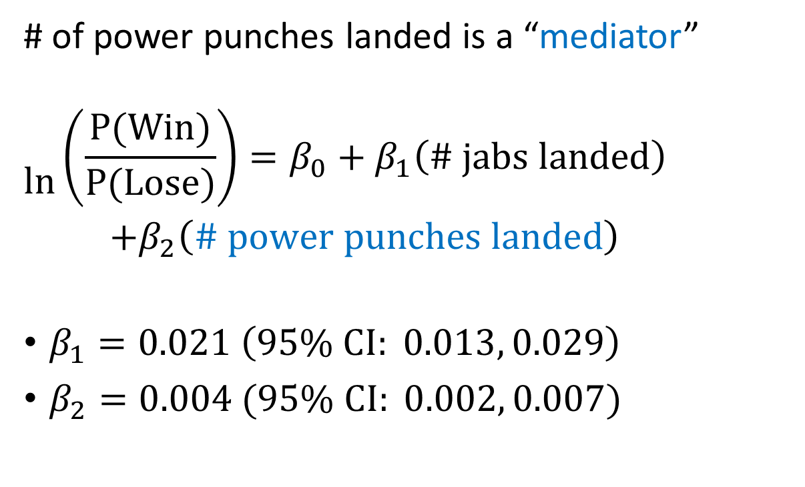
Model 3: “It ain’t about how hard you can hit”
# of power punches landed is a “mediator”
$$\ln{\begin{aligned}\left(\frac{P(Win)}{P(Lose)}\right)=β_{0}+β_{1}\left(\# jabs landed\right) \\ +β_{2}\left(\# power punches landed\right)\end{aligned}}$$
$β_{1}=0.021 \left(95\% CI: 0.013, 0.029\right)$
$β_{2}=0.004 (95\% CI: 0.002, 0.007)$
Which model should we use?
Notes:
“Landing jab can help land more power punches, which can help you win. “
“We can model the direct impact of landing a jab on winning”
“There is a statistically significant effect of the direct effect of jabs landed on winning”

Slide 14
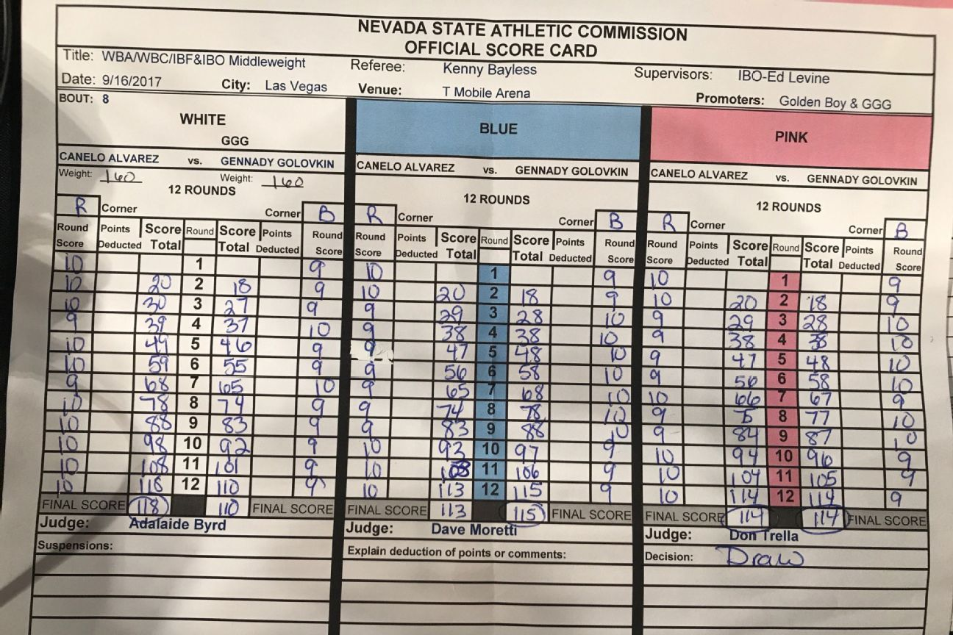
“We go to the score cards”

Slide 15
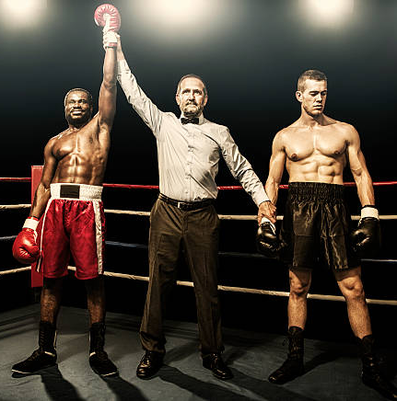
AIC & BIC: “We go to the score cards”
Balancing model fit with model complexity
Want a lower value for AIC and BIC
Model | AIC | BIC
Model 1 | 689 | 698
Model 2 (country) | 713 | 897
Model 3
Model 3 (power) | 681 | 694
Notes:
“The AIC and BIC scoring in favor of…”

Slide 16
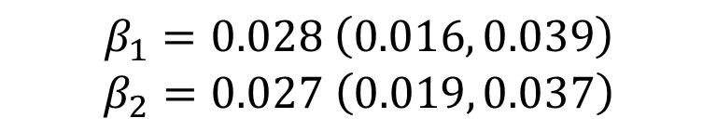
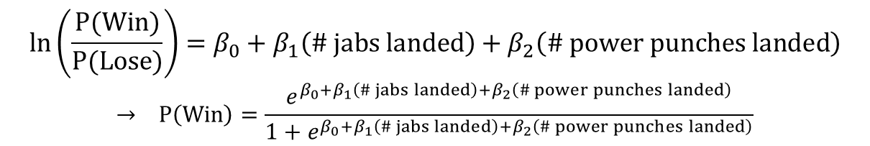
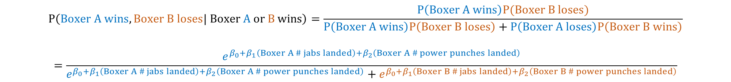
Model 4: “It’s just you and the other guy”
Logistic Regression:
Conditional Logistic Regression:
  Within-fight comparisons
  Given that there is only one winner in a matchup:
  What is the probability that Boxer A won and not Boxer B?
$$\ln\left(\frac{P(Win)}{P(Lose)}\right)=β_{0}+β_{1}\left(\# jabs landed\right)+β_{2}\left(\# power punches landed\right)$$
$$→ P\left(Win\right)=\frac{e^{β_{0}+β_{1}\left(\# jabs landed\right)+β_{2}\left(\# power punches landed\right)}}{1+e^{β_{0}+β_{1}\left(\# jabs landed\right)+β_{2}\left(\# power punches landed\right)}}$$
$$β_{1}=0.028 \left(0.016, 0.039\right)$$
$$β_{2}=0.027 \left(0.019, 0.037\right)$$
$$P\left(Boxer A wins, Boxer B loses| Boxer A or B wins\right)=\frac{P\left(Boxer A wins\right)P(Boxer B loses)}{P\left(Boxer A wins\right)P\left(Boxer B loses\right)+P\left(Boxer A loses\right)P\left(Boxer B wins\right)}$$
$$=\frac{e^{β_{0}+β_{1}\left(Boxer A \# jabs landed\right)+β_{2}\left(Boxer A \# power punches landed\right)}}{e^{β_{0}+β_{1}\left(Boxer A \# jabs landed\right)+β_{2}\left(Boxer A \# power punches landed\right)}+e^{β_{0}+β_{1}\left(Boxer B \# jabs landed\right)+β_{2}\left(Boxer B \# power punches landed\right)}}$$
Notes:
“Previously we modelled using a normal logistic regression”
“A boxing bout is between two fighters.”
“Alternatively, we propose to use the conditional logistic regression”

Slide 17
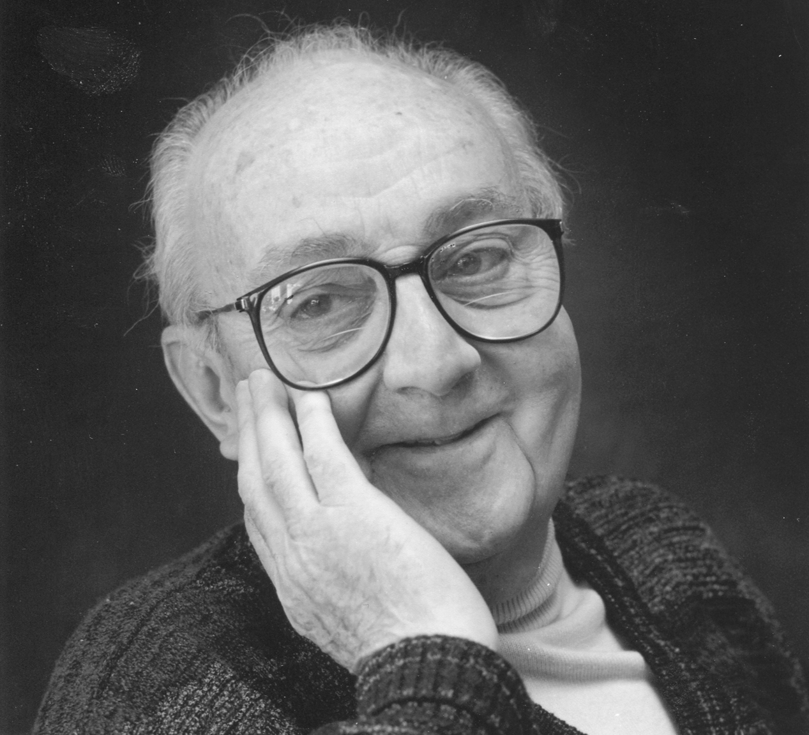
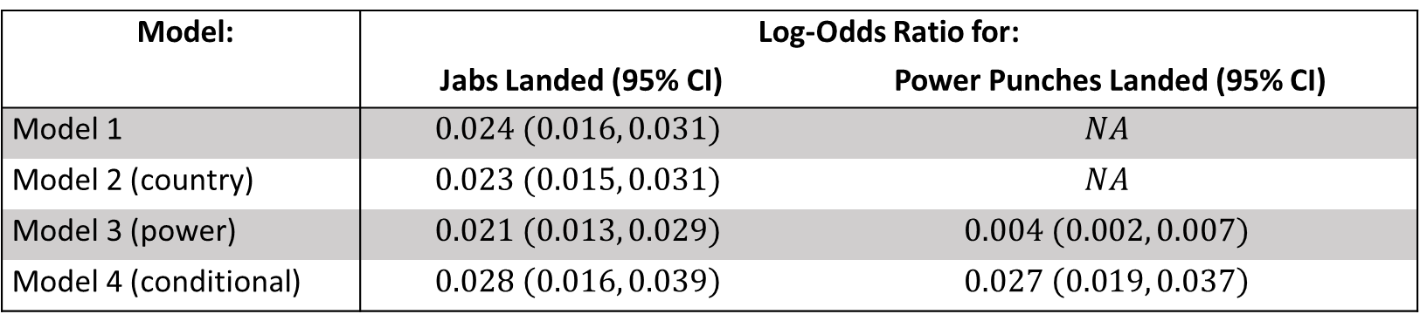
“All models are wrong, but some are useful” – George EP Box
Model: | Log-Odds Ratio for:
 | Jabs Landed (95% CI) | Power Punches Landed (95% CI)
Model 1 | $$0.024 (0.016, 0.031)$$ | $$NA$$
Model 2 (country) | $$0.023 (0.015, 0.031)$$ | $$NA$$
Model 3 (power) | $$0.021 (0.013, 0.029)$$ | $$0.004 (0.002, 0.007)$$
Model 4 (conditional) | $$0.028 \left(0.016, 0.039\right)$$ | $$0.027 \left(0.019, 0.037\right)$$
A good jab can indeed take you around the world.
But is the jab more important than power punches as Anthony Joshua and “the old saying” imply?
Notes:
“Altogether, we have the following results”
“Which model should we use?”
“British boxer, British Box”
“all the described models are useful and point to the same conclusion”
“Looking at this table, Model 3 scores it in favor of the jab, while Model 4 scores it a draw… How do you all score it?”

Slide 18
References
Agresti, Alan. 2002. Categorical Data Analysis. Hoboken, NJ, USA: John Wiley & Sons, Inc. http://doi.wiley.com/10.1002/0471249688 (February 24, 2021).
Allison, Paul D. 2009. Fixed Effects Regression Models.
Digitale, Jean C., Jeffrey N. Martin, and Medellena Maria Glymour. 2022. “Tutorial on Directed Acyclic Graphs.” Journal of Clinical Epidemiology 142: 264–67.
Gomez, Eric. 2021. “The Secret to Canelo’s Success? His Own Brand of Mexican Style.” ESPN.com. https://www.espn.com/boxing/story/_/id/31381706/the-secret-canelo-alvarez-success-crafting-own-brand-mexican-style-boxing (May 17, 2023).
Kleinbaum, David G., and Mitchel Klein. 2010. “Introduction to Logistic Regression.” In Logistic Regression, Statistics for Biology and Health, New York, NY: Springer New York, 1–39. http://link.springer.com/10.1007/978-1-4419-1742-3_1 (May 12, 2023).
Park, Hyeoun-Ae. 2013. “An Introduction to Logistic Regression: From Basic Concepts to Interpretation with Particular Attention to Nursing Domain.” Journal of Korean Academy of Nursing 43(2): 154–64.
Suttorp, Marit M. et al. 2015. “Graphical Presentation of Confounding in Directed Acyclic Graphs.” Nephrology Dialysis Transplantation 30(9): 1418–23.
Weisberg, Sanford. 2014. Applied Linear Regression.

Slide 19
Thank you!

